Slide 1
DOCUMENT STORAGE SOLUTION
Prepared by:
Lim Yong sheng
Odelia Tan hui zi
Muhammad Izdihar Bin Ibrahim

Slide 2
Table of content
About the project
Architecture Design
LoginService
FileService
RabbitMq
Recon Microservice
Demo

Slide 3
About the project
The team is required to write a software solution for a document storage using microservice architectural Style.

Slide 4
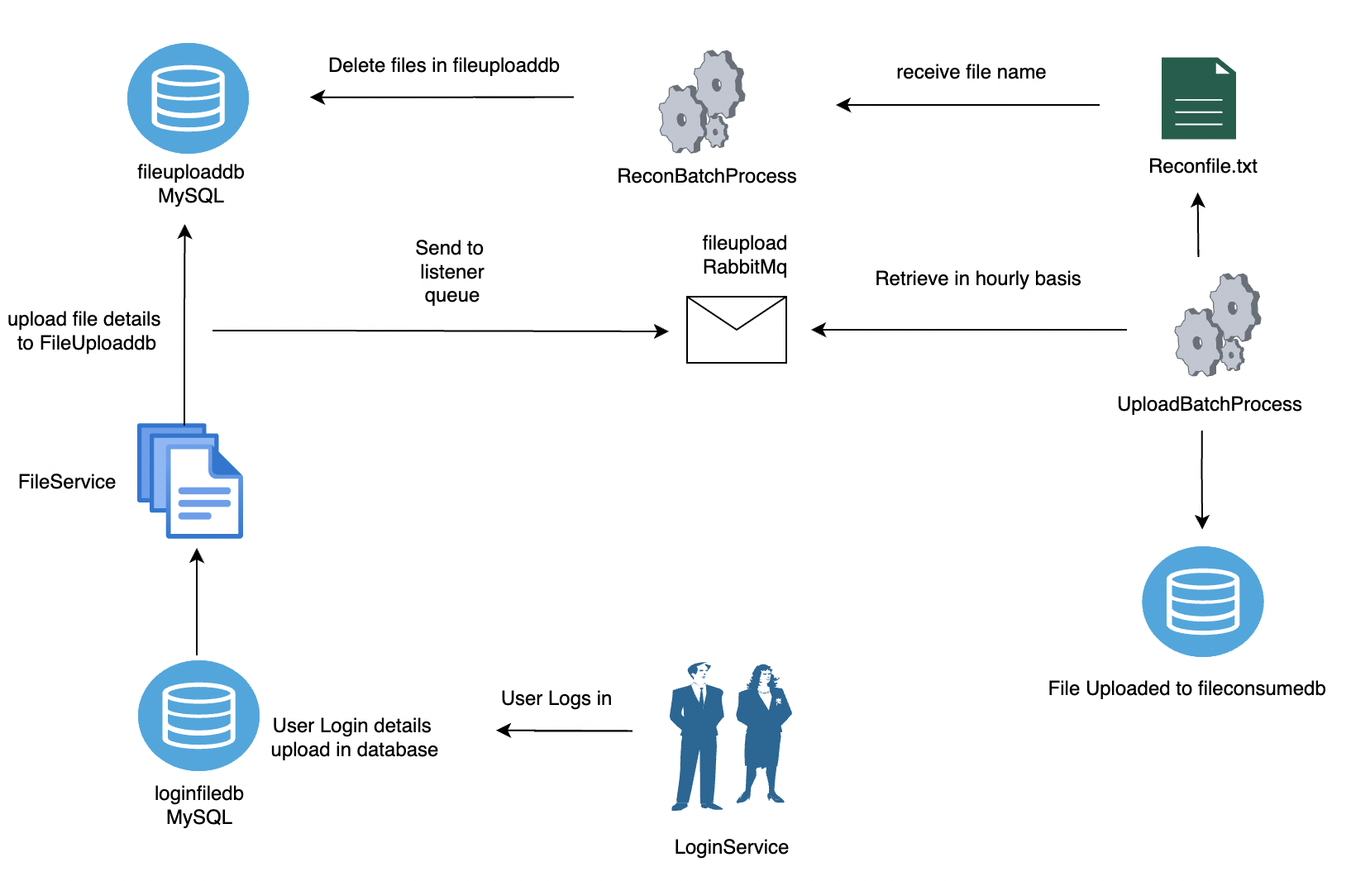
Architecture Design

Slide 5
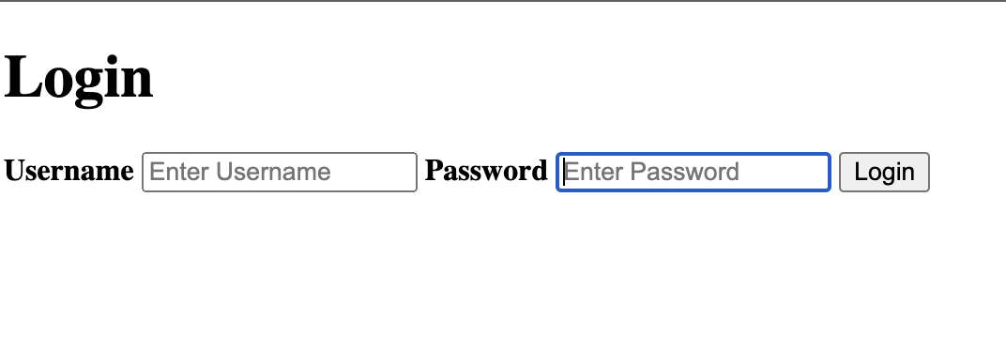
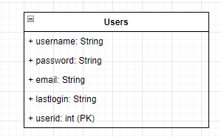
LOGIN Service
REST API
GET (/login)
Displays login page
POST (/login)
Logs user in after validation

Slide 6
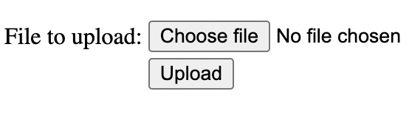
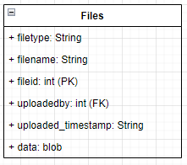
FILE Service
REST API
POST (/upload)
Upload file to file_db
GET (download/{fileId})
Download file by file id

Slide 7
Rabbit MQ
A messaging broker to send and receive message
The file will be converted to AMQP message

Slide 8
RECON MICROSERVICE
The Recon microservice(Recon MS) will get the recon file generated from the upload processing batch
The recon file contains the details of the files to be deleted
The Recon processing batch in the Recon MS will proceed to read the file and delete the records stored in fileuploaddb.
File details will be deleted

Slide 9
Task Assignment
Login Service & Api gateway – Odelia Tan Hui Zi
File Service & Architecture Design – Muhammad Izdihar Bin Ibrahim
Batch Processing , Recon MS & Rabbit MQ – Lim Yong Sheng

Slide 10

DEMO

